Slide 1
Automated Question Answering System
BY,
Bharath P

Slide 2
Problem Statement
Question Answering Task
Facebook Babi Dataset
Example: Task with single supporting fact
John is in the playground. Bob is in the office.
Where is John? A:playground
SUPPORTING FACT

Slide 3
Memory Networks
Memory Networks were introduced in 2014 as a work to be presented in International Conference on Learning Representations (ICLR) 2016.
Class of models that combine large memory with learning component that can read and write to it.
Authors of the paper : J. Weston, S. Chopra and A. Bordes
Simple Concept:
Store the text in memory
Transform them by using embedding matrices.
Now do computations over them to train the model.

Slide 4
End to End Memory Networks
Neural Network model with external memory.
Reads the memory with soft attention.
It accesses memory multiple times, each step being called a hop.
Uses back propagation to update the model.

Slide 5
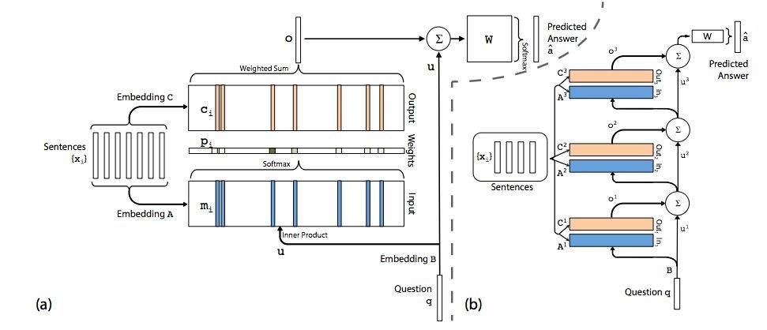
Architecture of End to End Memory Networks
Single layer version
Multiple layer version

Slide 6
Model Details
Input Sentences: x₁,x₂,....,x_{n} is taken
Sentences are embedded into memory vectors m_{i} and c_{i} by using embedding matrices A and C.
Question q is embedded into internal state u.
Matching is performed between u and m_{i} with Softmax function.
Output is calculated by the relation: o=∑ p_{i}c_{i}
Another Softmax is used to produce final predictio summing up o with u.
ns after

Slide 7
Results/Observations
Layers | Dropouts | Batch-size | Epochs | Results
LSTM(32) | 0.3 | 32 | 100 | 94.6%
LSTM(64) | 0.3 | 32 | 100 | 96.5%
LSTM(32), LSTM(32) | (0.5,0.5) | 32 | 100 | 92.4%
LSTM(32), LSTM(32) | (0.5, 0.5) | 32 | 200 | 96.9%
GRU(32) | 0.3 | 32 | 100 | 86.4%
GRU(64) | 0.3 | 32 | 100 | 87.4%
GRU(32), GRU(32) | (0.5,0.5) | 64 | 100 | 52.6%

Slide 8
Conclusion
The models with two or more layers required more training since there are more parameters that need to be set, but then have greater accuracies than the other models once trained completely.
Overall, LSTM based models performed better than GRU based models for this task.

Slide 9
Thank you!!

